Slide 1
4.7 Trojans and Backdoors

Slide 2
Trojan Horse
It is a program in which malicious or harmful code is contained inside
apparently harmless program or data in such a way that it can get control
and cause harm
OR
A Trojan, or Trojan horse, is a type of malware that conceals its true content
to fool a user into thinking it's a harmless file
Difference between Trojan and Virus : Virus can replicate itself,Trojan can’t
Trojans appear harmless but once the Trojan infected code is executed,it
performs malicious functions to harm computer system without user’s
knowledge

Slide 3
Trojan Horse Analogy
The term Trojan Horse comes from Greek Mythology about Trojan
War
For 10 years,Greek army could not enter Troy city
They designed a Wooden Horse which would carry 30 soldiers
One soldier named Sinon was kept outside the horse
He went to Troy city and told Trojans that Geek Army Has gone back,they abandoned me
I have got this horse as a gift of God
Trojans believed him and took him inside troy city and horse was wheeled inside the city as a victory trophy
At night when troy city was asleep,soldiers came out of the horse and opened the back door of city to Greek army
Greek army entered the troy city,destroyed it and ended Trojan War

Slide 4
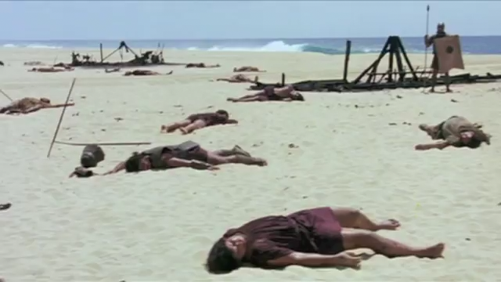
Troy Movie : Trojan War

Slide 5
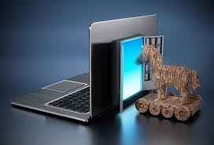
Trojan Horse Analogy in Cyber Security

Slide 6
How Trojans get into the system
From a web browser
Via e-mail
In a bundle with software downloaded
Through Portable media

Slide 7
Actions performed by Trojan
Erase,overwrite or corrupt data
Help to spread other malware
Deactivate or interfere with Antivirus/Firewall
Allow remote access to user’ computer
Upload and download files without your knowledge
Act as a keylogger
Sow down,restart or shut down the system
Reinstall themselves after being disabled
Disable task manager
Disable control panel
Gather e-mail addresses and use them for Spam

Slide 8
Types of Trojans
1.Backdoor Trojans -
This type of Trojan allows hackers to remotely access and control a computer, often for the purpose of uploading, downloading, or executing files at will.
2.Exploit Trojans -
These Trojans inject a machine with code deliberately designed to take advantage of a weakness inherent to a specific piece of software.
3.Rootkit Trojans -
These Trojans are intended to prevent the discovery of malware already infecting a system so that it can affect maximum damage
4.Banker Trojans -
This type of Trojan specifically targets personal information used for banking and other online transactions.
5.Distributed Denial of Service (DDoS) Trojans -
These are programmed to execute DDoS attacks, where a network or machine is disabled by a flood of requests originating from many different sources.
6.Downloader Trojans -
These are files written to download additional malware, often including more Trojans, onto a device.

Slide 9
Backdoor
It is a means of accessing a computer by bypassing security or authentication mechanisms
Backdoor works in background and is hidden form the user
A program developer may create a backdoor so that an application or operating system can be accessed for troubleshooting or other purposes.
However, attackers often use these backdoors that they detect and/or install themselves as part of an exploit.

Slide 10
What a Backdoor Does
Allows an attacker to create,delete,rename,copy or edit any file,execute various commands
Allows an attacker to change system settings,alter Windows registry
Allows to run,control and terminate applications
Allows to control computer hardware devices,modify relates settings,shut down or restart computer without user permission
Steals PII,valuable documents,passwords,login names,
Records all keystrokes

Slide 11
What a Backdoor Does
Distributes infected files to remote computers
Degrades internet speed,overall system performance
Decreases system security
Provides no uninstall feature
Sends all gathered data to a predefines e-mail
Infects files,corrupts installed applications

Slide 12
Do’s and Dont’s regarding Trojans and Backdoors
Do’s
Update your operating system and other softwares as soon as updates are made available from the software company. Cybercriminals tend to exploit security holes in outdated software programs
Protect your each of your accounts with complex, unique passwords.
Keep your personal information safe with firewalls.
Back up your files regularly. If a Trojan infects your computer, this will help you to restore your data.
Be careful with email attachments. To help stay safe, scan an email attachment first.

Slide 13
Do’s and Dont’s regarding Trojans and Backdoors
Dont’s
Don’t visit unsafe websites. Some internet security software will alert you that you’re about to visit an unsafe site, such as Norton Safe Web.
Don’t open a link in an email unless you’re confident it comes from a legitimate source.
Don’t download or install programs if you don’t have complete trust in the publisher.
Don’t click on pop-up windows that promise free programs that perform useful tasks.

Slide 14
Safety Measures against Trojans and Backdoors
1.Avoid connecting to and/or downloading any information form P2P
Networks
P2P network is a distributed network composed of systems that make their resources directly available to other systems without need for permission of central server
Peer systems are both suppliers and consumers
P2P networks enable faster delivery by bypassing central server
It shares desired as well as undesired things
Increase system’s exposure to malicious damage

Slide 15
Safety Measures against Trojans and Backdoors
2.Install Antivirus,Firewall,Trojan Remover software
Nowadays Antivirus softwares have built-in feature for protecting system not only form viruses nut also from worms,Trojans,etc.
Free Trojan remover programs are also available on web some of which are really good

